Slide 1
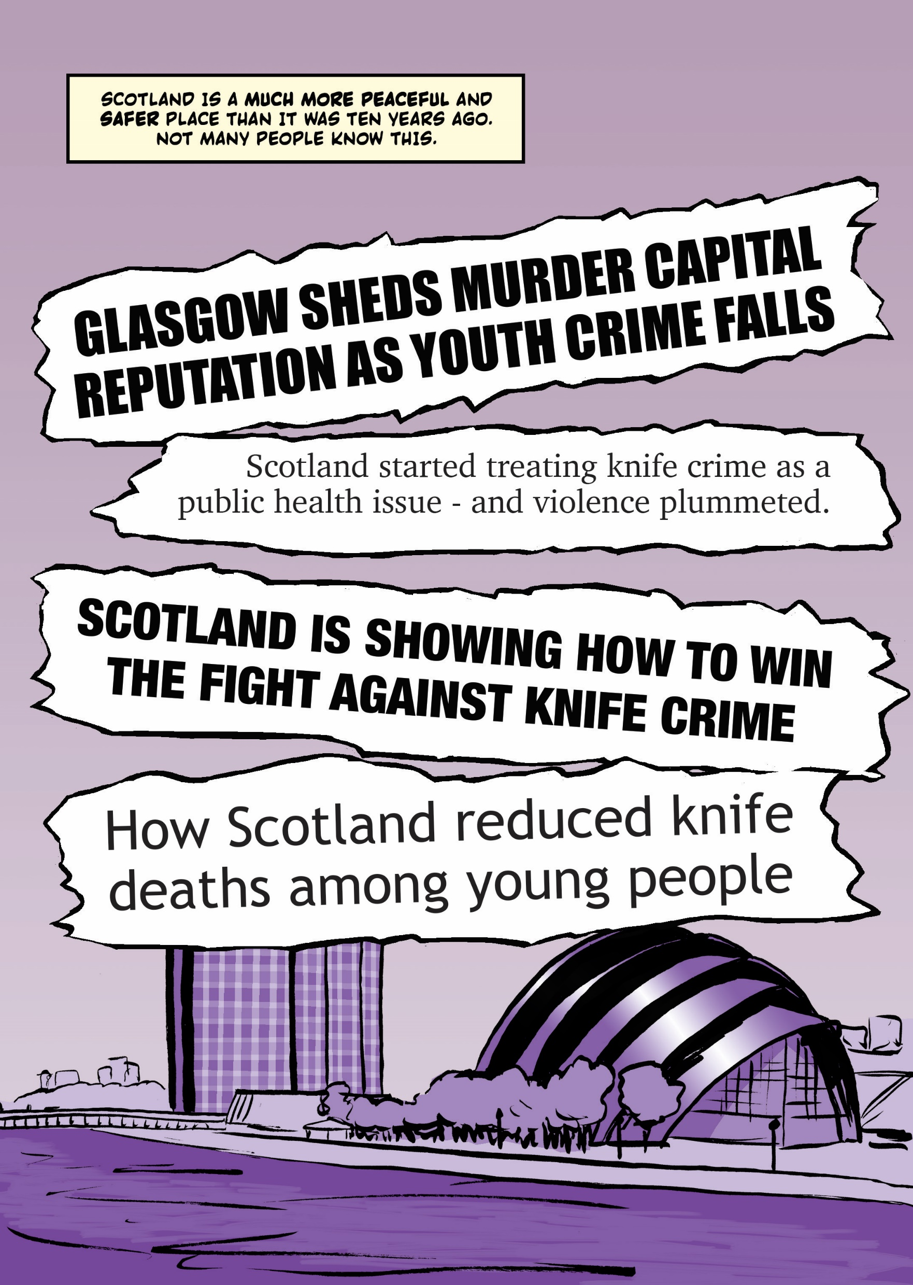
Knife Facts

Slide 2
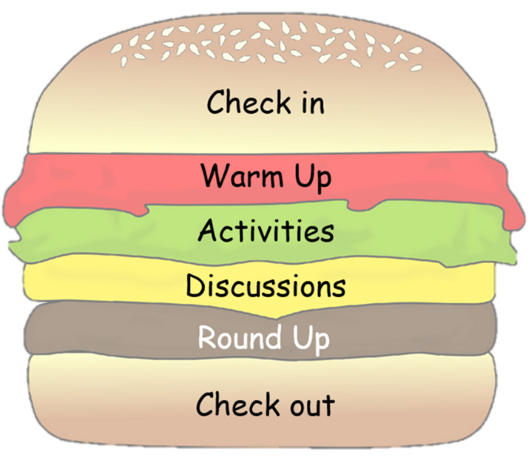
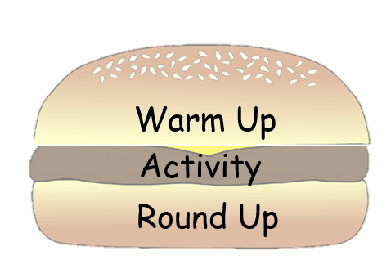
Choose your lesson toppings
These slides have been created to help you structure your Peer Education sessions. Choose elements from the sections below (you don't need them all) to build your session around your activity. Delete the slides you don't need and save your powerpoint. Remember to check the notes section for any instructions.

Slide 3
Topping Descriptions
Check in/Check Out - Allow for space and time for thoughts/feelings/learning to be shared.
Starter/Warm Up - A fun way to hook and conclude your lesson.
Activity - Where you introduce and explore your key points.
Discussion - Give your group time to talk about the topic, ideas and experiences.
Round Up - Sum up the key points of your lesson.

Slide 4
Resourse Content
Check in
Warm ups
Activities
Discussions
Round up activities

Slide 5
Check in

Slide 6
Check in
Example Questions
Describe how your feeling using a colour
What's one thing that you saw or heard from our last session that has stuck with you?
What was the best part of the past week for you?
What’s one thing you hope to get achieve from today’s session?
Notes:
Questions should be chosen based upon time and aim of your circle. Use a talking object to help control people talking over each other.

Slide 7
Warm Up

Slide 8
What do you already know?
Group Brainstorm
Notes:
Time: 7 minutes
Resources:
Flipchart paper
pens

Slide 9
Knife Facts
On the flipchart paper, write down everything you know which relates to knife crime.
For example:
type of weapons
consequences of carrying/using
personal experiences
Notes:
Put a 5 minute timer on the board.
Once the time is up, go around the groups and discuss some of their answers.

Slide 10
What is knife crime?
‘Knife crime’ includes offences where knives are used to inflict injury on another person, such as assault or homicide, or crimes involving the possession of a weapon.
There are offences that are specifically related to knife crime. These include:
the carrying of a knife in a public place without reasonable excuse or lawful authority (section 49 Criminal Law (Consolidation) (Scotland) Act 1995)
the selling of knives to young people under 16 years old
the sale of knives to people under 18 years old which are not designed for a domestic purpose (section141A Criminal Justice Act 1988).
Notes:
Give the participants a time limit for each stage ie. 1 minute think, 2 minutes pair

Slide 11
Knife Facts
22% of adults thought people carrying knives was common in 2009/10, but this has fallen to 12% over the last decade
Violent crime in 2017/18 did not commonly involve the presence of weapons. A knife was reported as being present in 7% of violent incidents where someone saw or heard what was happening.
A sharp instrument was the main method of killing for 58% (34) of homicide victims.
Crimes handling an offensive weapon account for 6% of ‘Other’ homicide crimes in 2017-18 (72 of these occurred within a prison and 128 in a school).
Over the ten year period from 2008-09 to 2017-18 weapon related crime has decreased by 60%. But it has gone up a bit recently (9% increase from 3,271 in 2016-17 to 3,570 in 2017-18).
Notes:
Give the participants a time limit for each stage ie. 1 minute think, 2 minutes pair

Slide 12
Activities

Slide 13
Harmometer
Think about the harm that is done by certain violent acts.
Notes:
Timing: 15mins
A print out of the harmometer image, or your own version hand-drawn onto a flip chart (you will need enough copies to work in small groups)
Sticky notes with the 12 statements on them. (You could make these into reusable cards and use blue tack to stick them on.)
Explain that as a group you are going to explore violent acts and how much harm they cause. As an opener you can ask about types of harm that the group can identify.
Remember that we are focusing on violence and knife crime, but other harms might be involved. For example, stress, fear and other factors that occur in the lead-up, during and after an incident.

Slide 14
Place the statements on the Harmometer from most harm to least.
Using a small knife
Carrying a large six-inch knife to scare off other gangs
Stabbing someone in the bum
Carrying a knife for protection
Keeping it to yourself that your friend is carrying a knife
Getting someone under 16 to carry a knife for you
Reporting someone carrying a knife
Telling someone you're worried because you've been threatened
Asking someone to help you out because your friends are getting more heavily involved in violence
Getting a bit drunk on a night out and going home while the going is good
Totally losing it on a night out and taking it out on someone that you don't like
Losing the head with your friend because they've told you they have a knife
Getting your friends to help you 'send a message' to someone you think has done you wrong
Sending hate messages by phone to someone you can't stand
Notes:
Use these categories and write them onto sticky notes, then place them on the harmometer according to which ones cause the most harm and which ones cause the least harm.

Slide 15
Harmometer
What are your top/bottom three?
How hard/easy was it to decide on your choice ranking?
Where there any that provoked more debate than others?
Were there some scenarios that were worse than others?
What do you think of people who behave in these ways?
Who else may get hurt by these behaviours?
Notes:
The point of the exercise is that there are no real right or wrong answers. All of these situations put you at risk. There is no safe place to stab someone. Carrying a knife is illegal and you can be prosecuted at any age for possession, even if you say you are carrying it for fear or protection. If it's your friend that's involved, you can be prosecuted under 'joint enterprise'. Always make sure you try to calm them down or talk them out of it. And best of all, speak to an adult you can trust. If there is no violence but there is incitement it can still be an offense that is considered 'harassment' or 'malicious communications' if it involves social media. You are welcome to watch the 'Don't be in the Dark' video for more information.

Slide 16
Don’t be in the dark
Facts about knife crime and its consequences
Notes:
Timing: 15mins
A screen and PC or device to play the video.
Introduce the topic by explaining that we are going to watch a series of videos that ask us how well we know the facts on knife crime and the law.
You can have different voting areas in the room that people move to or you can do a show of hands. Each video lasts around 1 minute.

Slide 17
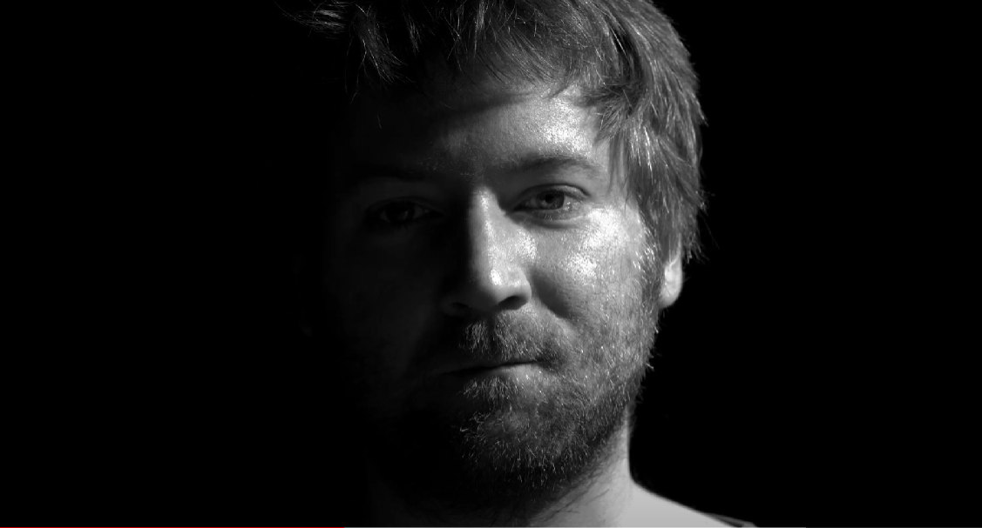
Don’t Be in the Dark About Knife Crime
Notes:
Introduce the topic by explaining that we are going to watch a series of videos that ask us how well we know the facts on knife crime and the law.
You can have different voting areas in the room that people move to or you can do a show of hands. Each video lasts around 1 minute.

Slide 18
What happens if you're caught with a knife?
Notes:
Introduce the topic by explaining that we are going to watch a series of videos that ask us how well we know the facts on knife crime and the law.
You can have different voting areas in the room that people move to or you can do a show of hands. Each video lasts around 1 minute.

Slide 19
What happens if you're caught with a knife?
Notes:
Introduce the topic by explaining that we are going to watch a series of videos that ask us how well we know the facts on knife crime and the law.
You can have different voting areas in the room that people move to or you can do a show of hands. Each video lasts around 1 minute.

Slide 20
What are the consequences of carrying a knife?
Notes:
Introduce the topic by explaining that we are going to watch a series of videos that ask us how well we know the facts on knife crime and the law.
You can have different voting areas in the room that people move to or you can do a show of hands. Each video lasts around 1 minute.

Slide 21
What happens if you use a knife on someone?
Notes:
Ask the group if they were surprised by any of the facts. Reinforce that it's important to know about the facts, your rights and the law because you never know when you'll be in the wrong place at the wrong time.
It's making the right decisions that are important. They've made the right choice just to be part of this group and take part in this activity.

Slide 22
Maybe aye, maybe no
An interactive game to explore the truth about knife crime.
Notes:
Timing: 15mins Resources: link on facts about knife crime.
Yes/No signs

Slide 23
Where do you stand with the following statements?
YES/AGREE UNSURE NO/DISAGREE
Notes:
Ask everyone to go to the middle of the room. Explain that you are about to read a number of statements and the answer is Yes (Agree) or No (Disagree). Designate one side of the room for Yes and the opposite side for No..
Knife crime is on the increase - FALSE
Knife crime has dramatically reduced in Scotland and is no longer as common as it was. In 2009 (the year No Knives Better Lives started) you were 64% more likely to risk injury through stabbing.
Scotland has a worse problem than England with knife crime - FALSE
Whereas Scotland has often had a reputation for violence (Glasgow used to be referred to as the Murder Capital of Europe in the mid 2000s), the reality is very different these days. The problem of knife crime is worse in London and seems to be fuelled by violent gangs and organised crime rings. Other cities in the Midlands are experiencing issues similar to those in London. By comparison, Scotland is relatively peaceful, though this is not a reason to be complacent about tackling knife crime.
Men are more likely to carry knives than women - TRUE
A lot more likely! 85% of people convicted of carrying knives were men.
Women are more likely to be victims of knife crime - FALSE
Knife crime is predominantly a male on male activity. Men are far more likely to be the victims of knife crime than women.
Most people who carry knives are under 25 - FALSE
The average age of someone convicted of carrying a knife in Scotland is 29. Most young people do not carry knives. We think that knife carrying is not seen as either cool or safe amongst young people.
It’s legal to carry a knife - FALSE
It is illegal to carry a knife or offensive weapon in a public place without a reasonable excuse. Reasonable excuses include work use, such as knives for carpet fitting and fishing, but this only applies whilst actually in the workplace. You can get up to 4 years for carrying a knife.
It’s more likely that you will be stabbed by a stranger - FALSE
Most people who are stabbed know the perpetrator. You are unlikely to be stabbed by a stranger.
Police can stop and search you if they think you are carrying a knife - TRUE
Police can legitimately stop and search you if they suspect you of carrying a knife

Slide 24
How… does what we ‘think’ we know about knife crime compare with the truth?
Notes:
Come back together as a group and discuss what we think we know about knife crime and how this compares with the truth.

Slide 25
But They Look Like They Would...
A group activity to explore stereotypes and assumptions.
Notes:
A group activity to explore stereotypes and assumptions.

Slide 26
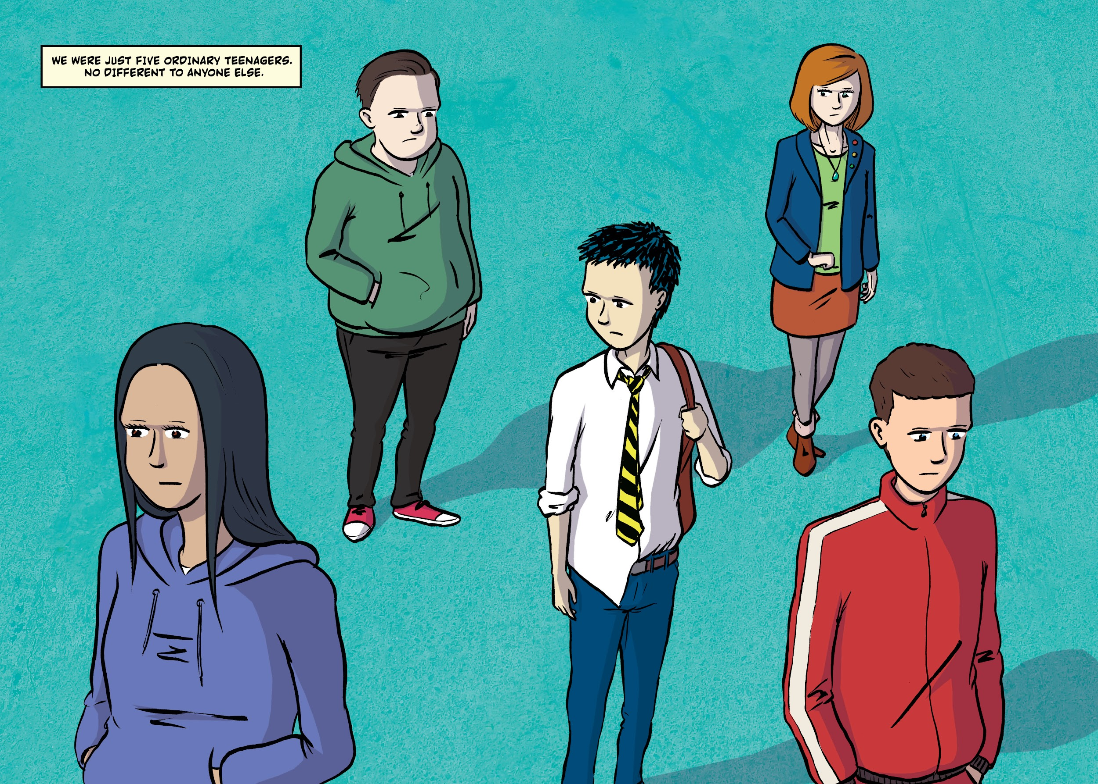
Notes:
Split into pairs and discuss who in the picture they think is more likely to carry a knife and why?
List the assumptions we make about others. Think about why any of the characters might carry a knife. Invite each pair to share their discussion with the whole group.
Who is most likely to carry a knife?
Why did you choose this person?
Why do people carry a knife?
Why would you or why would you not carry a knife?
Did we pick the person that we thought was most like us, or least like us?

Slide 27
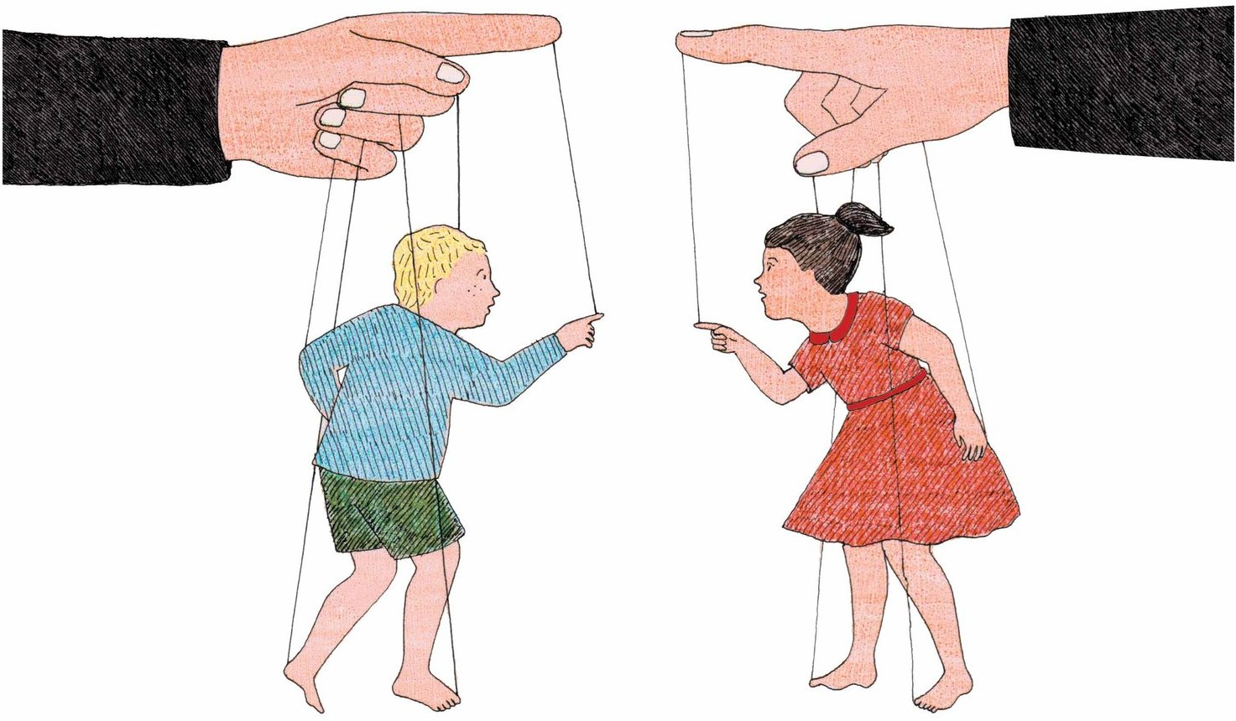
Video: Prejudice
Notes:
The simple answer is that anyone can fall into the trap of carrying a knife. But doing so is much more likely to put you at risk or harm than not carrying one.
However, prejudices can make us fearful and lead to the wrong assumptions, like feeling we need to protect ourselves when we might be safe. Watch the video to learn more about prejudice from the Anne Frank Foundation.

Slide 28
Discussions

Slide 29
Yes or No
The purpose of this discussion is to tackle some of the myths about knife crime, so that everyone fully understands that violence is not acceptable or normal.
Notes:
Timing: 10mins
Sometimes people get caught up in violence because people talk about it in ways that makes it seem normal. Violence and knife crime is not normal. Discussions like this one help dispel any myths and work out what is real.
Ask group members to respond to each statement with an 'aye' or 'naw' or whatever version of yes and no you use in your local dialect. Then go on to explain why you chose each answer. The real answer is in brackets.
1...
Men are more likely to carry knives than women. (Aye)
2...
It is more likely that you will be stabbed by a stranger than someone you know. (Naw)
3...
Police can stop and search you if they think you are carrying a knife. (Aye)
4...
Most people who carry knives are under 25. (Naw, they are usually over 25)
5...
Carrying a knife is a good way to protect yourself in a risky area. (Naw, carrying a knife can lead to using it. Or you can be prosecuted for carrying.)

Slide 30
Up or Down
Thinking about knife crime statistics and whether they have risen or fallen in Scotland in recent years.
Notes:
Pick something high that everyone has to touch for 'up' and something low that they touch for 'down'. This can be as simple as standing up and crouching down, or touching a basketball hoop and a bench, or they can stand up/sit down, or put a thumb up/thumb down depending on where you are and how much energy you want to generate.

Slide 31
UP
Decide whether the statistics in the following statements have gone UP or DOWN.
DOWN
[
Notes:
Here are the answers:
Crimes associated with offensive weapons (down by 61% in the last 10 years)
Convictions of young people (down by 85%)
Sexual and nonsexual crimes (up due to a new way of recording domestic violence)
Hate crime (is on the rise)
Crime levels since the lockdown (down by 25%)

Slide 32
Lisa's
VIDEO: How Scotland is Curing Crime
Notes:
https://www.noknivesbetterlives.com/lived-experiences/lisas-story-2/

Slide 33
Round Up

Slide 34
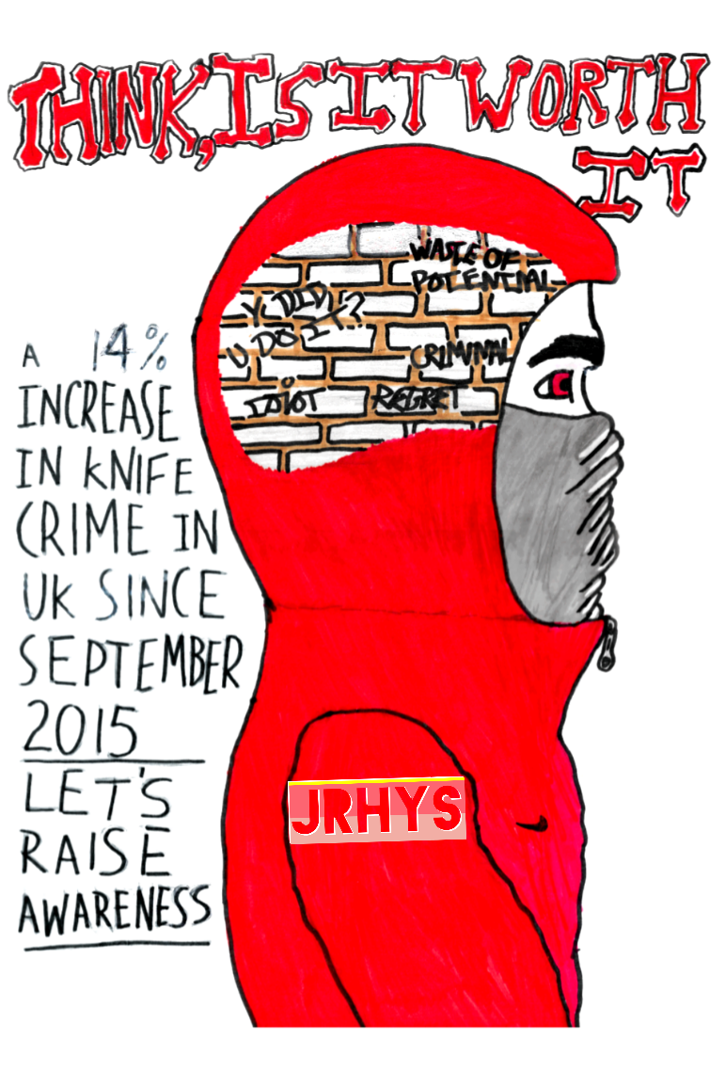
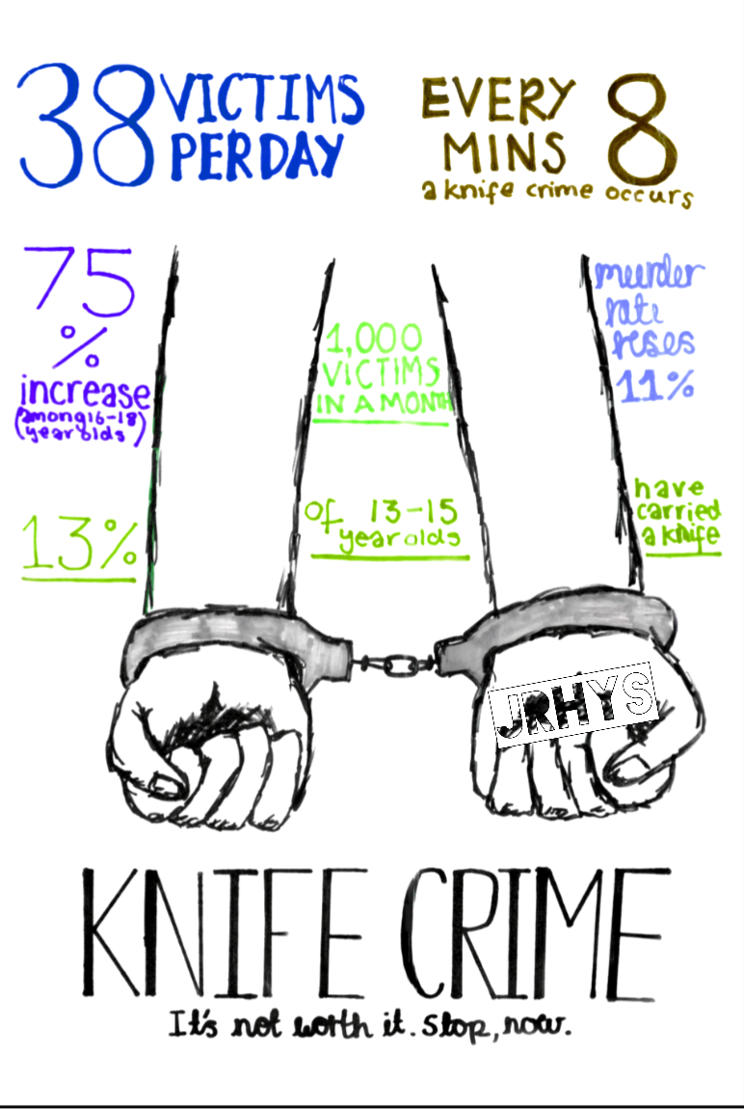
Poster
Create a poster busting the myths about Knife crimes
Notes:
Remind participants:
No images of knives or blood
Ensure their facts are accurate

Slide 35
Kahoot
Check what you know with a quiz
Notes:
Scenario cards
Dice with the 5Ds labeled or relate a numbered dice to the strategies

Slide 36
Check Out

Slide 37
Check out
Example Questions
What are two things you learned?
What is the most interesting thing you’ve learned?
Think of one thing you have learned in the session that you can apply to another part of your life. What is it, and how can you apply it?
What was your favorite activity in the session? Why?
What was your least favorite activity in session? Why?
What would you tell your parents or guardians you did in this session?
How does something you learned connect to what you already knew?
How did it extend your thinking further?
What questions do you still have?
Notes:
Questions should be chosen based upon time and aim of your circle. Use a talking object to help control people talking over each other.

