Slide 1
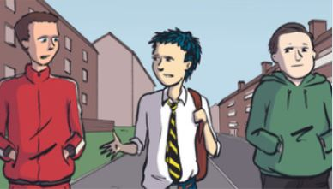
Positive Masculinity

Slide 2
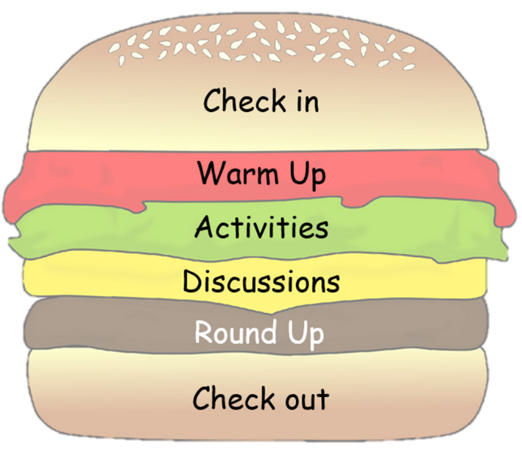
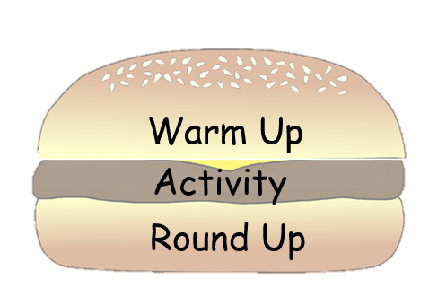
Choose your lesson toppings
These slides have been created to help you structure your Peer Education sessions. Choose elements from the sections below (you don't need them all) to build your session around your activity. Delete the slides you don't need and save your powerpoint. Remember to check the notes section for any instructions.

Slide 3
Topping Descriptions
Check in/Check Out - Allow for space and time for thoughts/feelings/learning to be shared.
Starter/Warm Up - A fun way to hook and conclude your lesson.
Activity - Where you introduce and explore your key points.
Discussion - Give your group time to talk about the topic, ideas and experiences.
Round Up - Sum up the key points of your lesson.

Slide 4
Resourse Content
Check in
Warm ups
Activities
Discussions
Round up activities

Slide 5
Check in

Slide 6
Check in
Example Questions
Describe how your feeling using a colour
What's one thing that you saw or heard from our last session that has stuck with you?
What was the best part of the past week for you?
What’s one thing you hope to get achieve from today’s session?
Notes:
Questions should be chosen based upon time and aim of your circle. Use a talking object to help control people talking over each other.

Slide 7
Warm Up

Slide 8
Last Man Standing
What does positive masculinity mean to you?
Notes:
Time: 10 minutes
Resources:
Whiteboard or paper
Whiteboard pen or pen

Slide 9
Last man standing
You have two minutes to write down as many words as you can that you relate to positive masculinity
Once the time is up, one person from each group will stand and take turns reading out their answers. If you repeat a word or don’t have any left, you need to sit down.
The person left standing at the end of the challenge is THE man.
Supportive
An individual
Self aware
Reject pressures
Notes:
Give the participants a time limit for each stage ie. 1 minute think, 2 minutes pair

Slide 10
Notes:
What do you think of their definition?
To what extent do you agree of disagree with their statement

Slide 11
Positive Masculinity
Using the terms from ‘Last man standing’ and the podcast to help you, create your own definition for what positive masculinity means to you.
Notes:
Give the participants a time limit for each stage ie. 1 minute think, 2 minutes pair

Slide 12
Activities

Slide 13
The Gendered Lens
Scotland has a dominant masculine culture, and in some places it's stronger than others. We are all part of promoting it regardless of what gender we identify as. But it doesn't have to be that way.
Notes:
Timing: 15mins
A few pairs of cheap sun-glasses (optional). Really big ones from the pound shop will work well.
Stickers with male/female/ lesbian/gay/ bi-sexual/ trans-sexual / non-binary (not male or female).
Print-off or link to the handout.

Slide 14
The Gendered Lens
Non-binary
Gay
Female
Notes:
Put the stickers on one lense of each pair of glasses and remove the other so that people can see each other with one eye.
Put the glasses in a box and invite group members to pull out a pair and put them on.
If you don't have glasses, just give out cards, or hold up a sheet or card with a different gender role on it. The handout link gives you a range of statements to ask. If you identified as the gender on the glasses you are wearing, how would you feel about doing any of the following (there are more examples on the handout):
Wear the colour pink
Play rugby
Get emotional and cry
Work in an underwear shop
Take a Rottweiler dog for a walk
Carry a bag over your shoulder
Buy sanitary towels for a friend

Slide 15
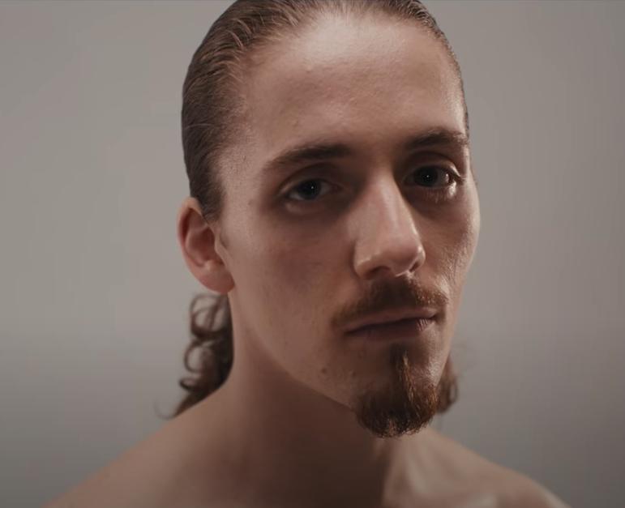
VIDEO: A Guide To Being A Man

Slide 16
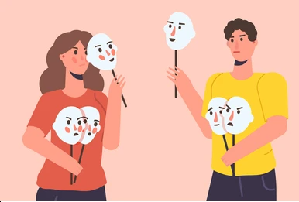
Breaking societies glasses
In your groups, come up with a short role play of how you would encourage a friend if they wanted to do something that goes against their gender identity.
Notes:
End by encouraging people to role-play how they would encourage a friend to 'go for it' if they wanted to do something that goes against their gender identity. Let the group come up with their own ideas of things they'd like to try but were afraid to because of their gender.

Slide 17
Out Of The Box
This activity looks at what it is that puts men inside the box and how to get out of it.
Notes:
Timing: 30mins
A large empty box, preferably one without too much writing on it
Marker pens
Paper
Ask the group who is ‘man’ enough to go into the box. On the outside of the box invite the group to use marker pens to write down all of the things that they think keep men in a box.
Invite members to read out to the person in the box what they have written on the outside. Ask the person in the box if they relate to any of these things. Here are some prompts:
not expressing your emotions
not showing weakness
being powerful and in control
viewing women as objects/property
being fit and sporty
don't need help to make decisions

Slide 18
Out Of The Box
Write down one thing that they think will help the person inside to break out of the 'man box' (without using any physical force).
Share his feelings
Increase his confidence
Be an individual
Notes:
Now give each member a sheet of paper and ask them to write down one thing that they think will help the person inside to break out of the 'man box' (without using any physical force). Remember the box is a metaphor, we're not trying to escape from a real box, but the box we can't see that has a negative effect. One by one ask each person to read out their suggestion and tape it onto the box. Ask the person inside the box, which of the suggestions they would be willing to try first. In what way would group members be able to help our 'man in the box' break out of the box without using any force or aggression. Working together, everyone should pick a safe part of the man's body and with his consent, count to three and quickly lift him out of the box and gently place him down.

Slide 19
Out Of The Box
We all need to work together to help boys and men break out of the box
Notes:
Have a look at the 12 healthy steps to manhood [see the download]. As a group or in smaller groups draw an image of the kind of world we would have if everyone followed these steps. Summarise by asking each group member which step they think they might try out for themselves. If you want to and have time, you can show the video from Kevin Powell and Tony Porter (A Call to Men) on decoding the man box. If you have young women, or non-binary group members it's important to tease out their perceptions of masculinity. For example, most violence against women is committed by men. Women that get involved in knife crime often say that they are trying to behave like males, to act tough and protect themselves from abuse by men. Mothers and females in families and communities often reinforce the stereotypes that keep people in the 'man box'. We all need to work together to tackle these issues.

Slide 20
What do you want to be?
Discover ways to stick to the path of being who we want to be.
Notes:
Timing: 20mins
Paper
Pens
Glue
Old magazines
Scissors
Screen and project or TV/device to play the video

Slide 21
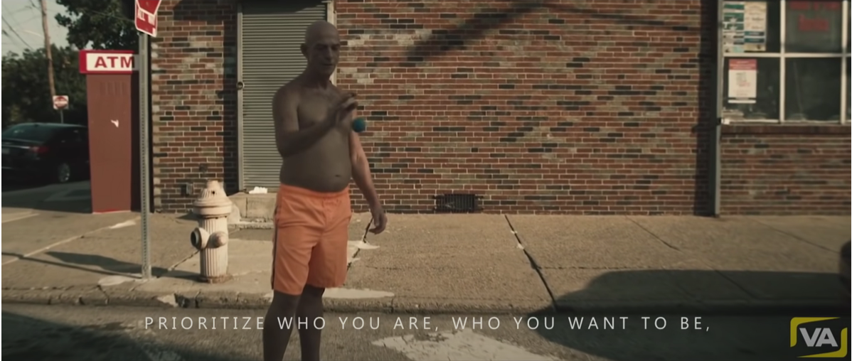
Lisa's
VIDEO: 5 Minutes for the NEXT 50 Years of Your LIFE

Slide 22
What do you want to be?
What or who are you not?
What is success to you?
What or who eats at your soul?
What can you quit, put down or do less or move on from?
What can you thank yourself for?
What gives you joy or honest pain?
Notes:
Group members will work in pairs or small groups. Take a large sheet of paper and draw out a hill shape. Use pens or cut out and glue on relevant images and words from old magazines to respond to the following questions raised by the video:
What or who are you not?
What is success to you?
What or who eats at your soul?
What can you quit, put down or do less or move on from?
What can you thank yourself for?
What gives you joy or honest pain?
Take photos of the images created so that group members can look at them in their own time. Ask if any group members are happy to share one thing that they don't want to be any more, after doing this exercise? Send your images to us on Twitter @nkblscotland There is a link to a wikihow with 3 ways to be the person you want to be, for anyone looking for more tips and advice.

Slide 23
Discussions

Slide 24
Black and White Town
Using song lyrics and a video to discuss the role of gender and masculinity in violence.
Notes:
Timing: 15mins
Watch the video of 'Black and White Town' by a band called The Doves. Either share a handout of the lyrics or look at them on a screen or device.
Although the band are from England, the video was filmed in Summerston Glasgow by Lynne Ramsay.

Slide 25
Lisa's
VIDEO: Doves – Black and White Town
Notes:
1...The opening lines of the song are "Here comes the action, here it comes at last. Lord give me a reaction, Lord give me a chance."
What do you think this means?
2... What comment is the video making about different gender roles and the expectations we grow up with? [Masculine, feminine, LGBTQ+]
3...The song suggests that a lot of fears prey on your mind in the black and white town.
What can you do to escape these negative thoughts and fears? Is fear different for different genders?
4...On the other hand, there is also a sense of excitement, that it's the first time the boy in the video has had some action or been involved in a fight - like it is a right of passage for becoming a teenager.
Are there other ways to move into your teens or different ages and stages?
5...The dark reality is that a violent culture means that people living in a 'black and white town' wherever that is, expect to end up 'ten feet under' and might never grow old.
Would learning to handle our emotions as men and gender roles differently, change the way people live in the black and white town? Do we need better ways to celebrate moving into different ages and stages as we grow up?

Slide 26
The Man Box
An opportunity to discuss the questions that were asked as part of the 'man box' research in the UK, US and Mexico.
Notes:
Timing: 15mins
Research in the USA, Mexico and the UK discovered that young men who identify with masculine stereotypes are in the 'man box' and have a lot in common.
See how you would respond to the questions.
1...
Does your family and friends have rigid ideas and norms about what “real men” should believe and how they should behave?
2...
Should boys or people who identify as male be taught how to care for others and take care of the house, or should they be preparing to go out and earn money for the family?
3...
Is it okay for a man/male to say no to sex or is it manly to be 'hyper sexual'?
4...
Do men and boys need to be aggressive, controlling and dominant?
5...
Should a man or someone who identifies as male be able to show his emotions and cry?

Slide 27
Mixing Mark’s Emotions
Using Mark's story, we reflect on Mark's emotions as a young man growing up in Scotland.
Notes:
Timing: 15mins
When watching the video Mark's Story, ask the group to think about the different roles played by different genders in the story.

Slide 28
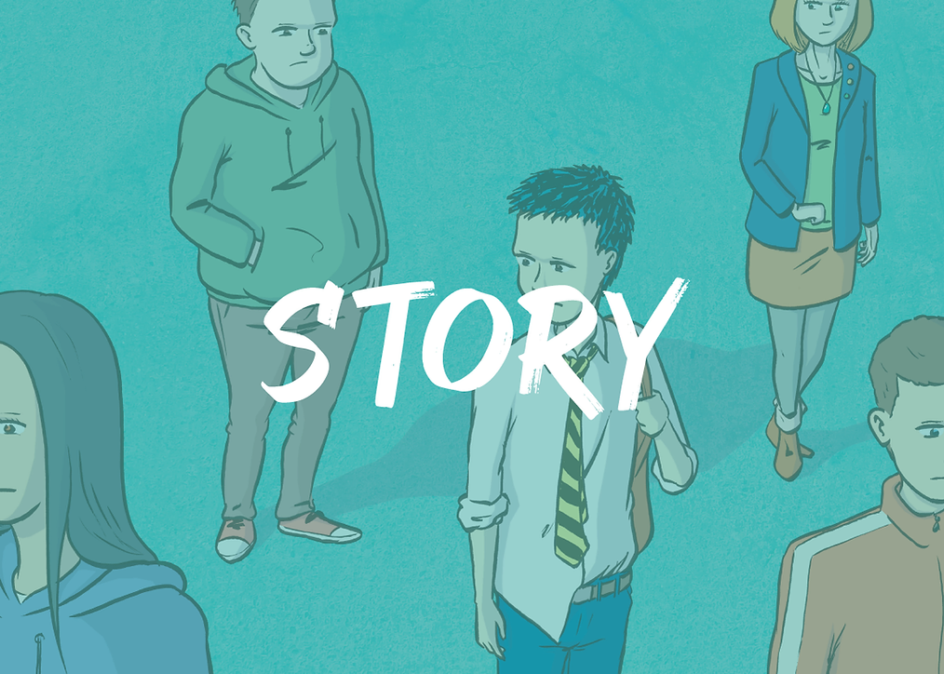
Mark's
Notes:
1...
What role do women take on in the video? Is it different for younger and older women?
2...
What role do the men take on in the video? Is it different for younger and older men?
3...
Are the expectations on Mark as a young man positive or negative?
4...
How difficult would it be for Mark to follow the advice the women in his life give him? Is it possible to break free from the expectations on Mark to fight Ian?
5...
An interesting development since the story was made, is that after being cast for this film Connor Newall, who plays Mark had his photo sent to a modelling agency.
Since then he has become a successful model in fashion magazines such as GQ and Vogue and clothing brands such as Dsquared and Stone Island. Although Connor grew up in a similar area to Mark, his real life is now very different from the stereotypes of Mark's story.
What stereotypes exist for us and how can we break free from them?

Slide 29
Round Up

Slide 30
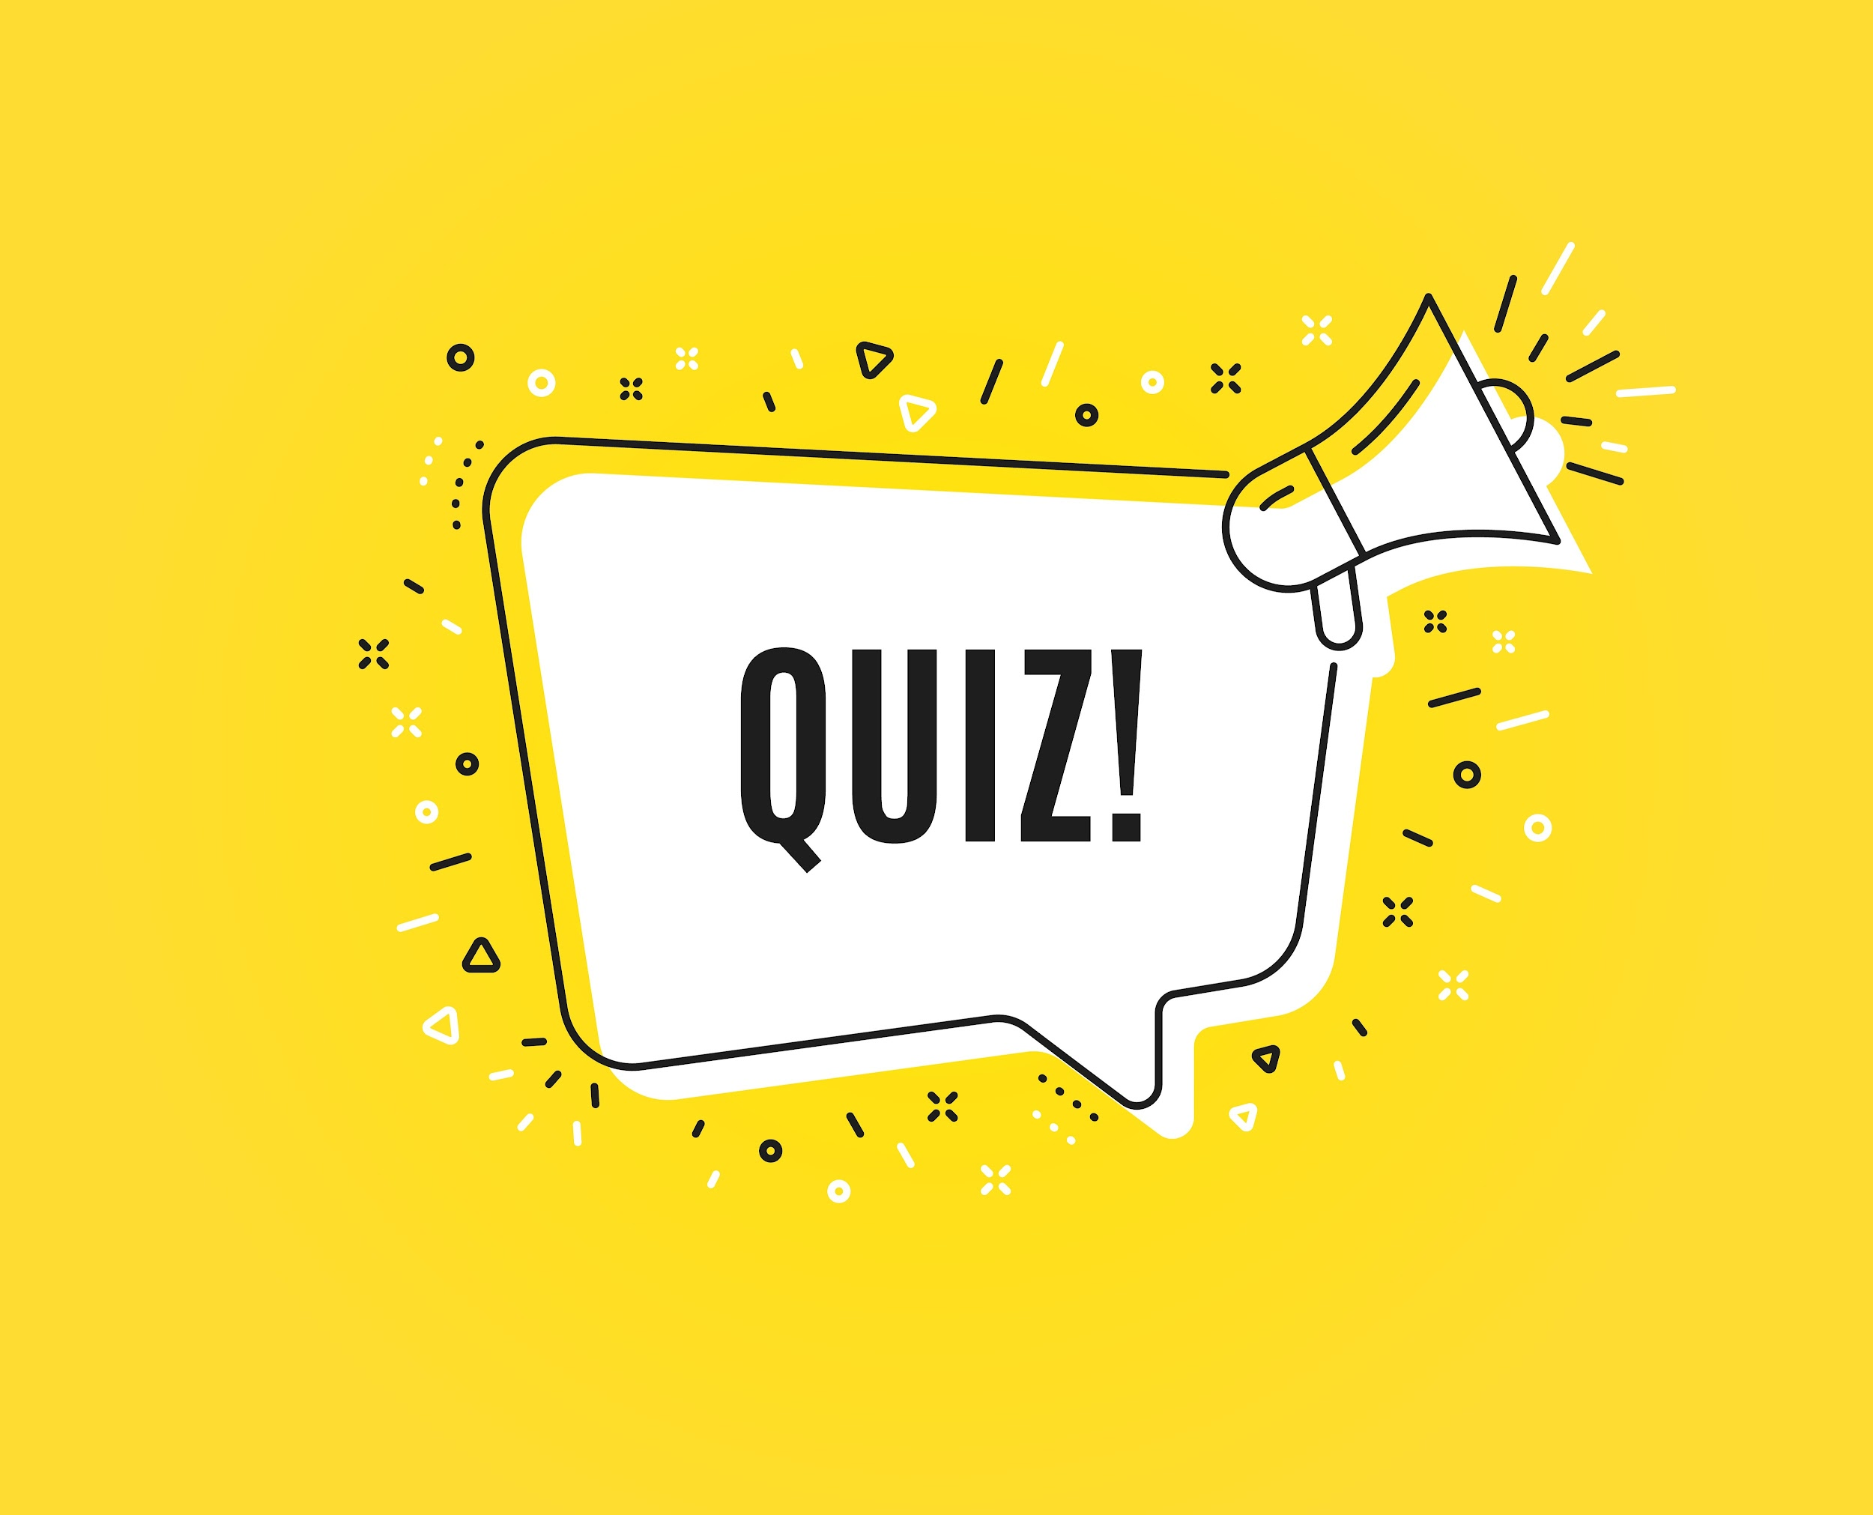
Kahoot
Check what you know with a quiz
Notes:
Scenario cards
Dice with the 5Ds labeled or relate a numbered dice to the strategies

Slide 31
Check Out

Slide 32
Check out
Example Questions
What are two things you learned?
What is the most interesting thing you’ve learned?
Think of one thing you have learned in the session that you can apply to another part of your life. What is it, and how can you apply it?
What was your favorite activity in the session? Why?
What was your least favorite activity in session? Why?
What would you tell your parents or guardians you did in this session?
How does something you learned connect to what you already knew?
How did it extend your thinking further?
What questions do you still have?
Notes:
Questions should be chosen based upon time and aim of your circle. Use a talking object to help control people talking over each other.

