Slide 1


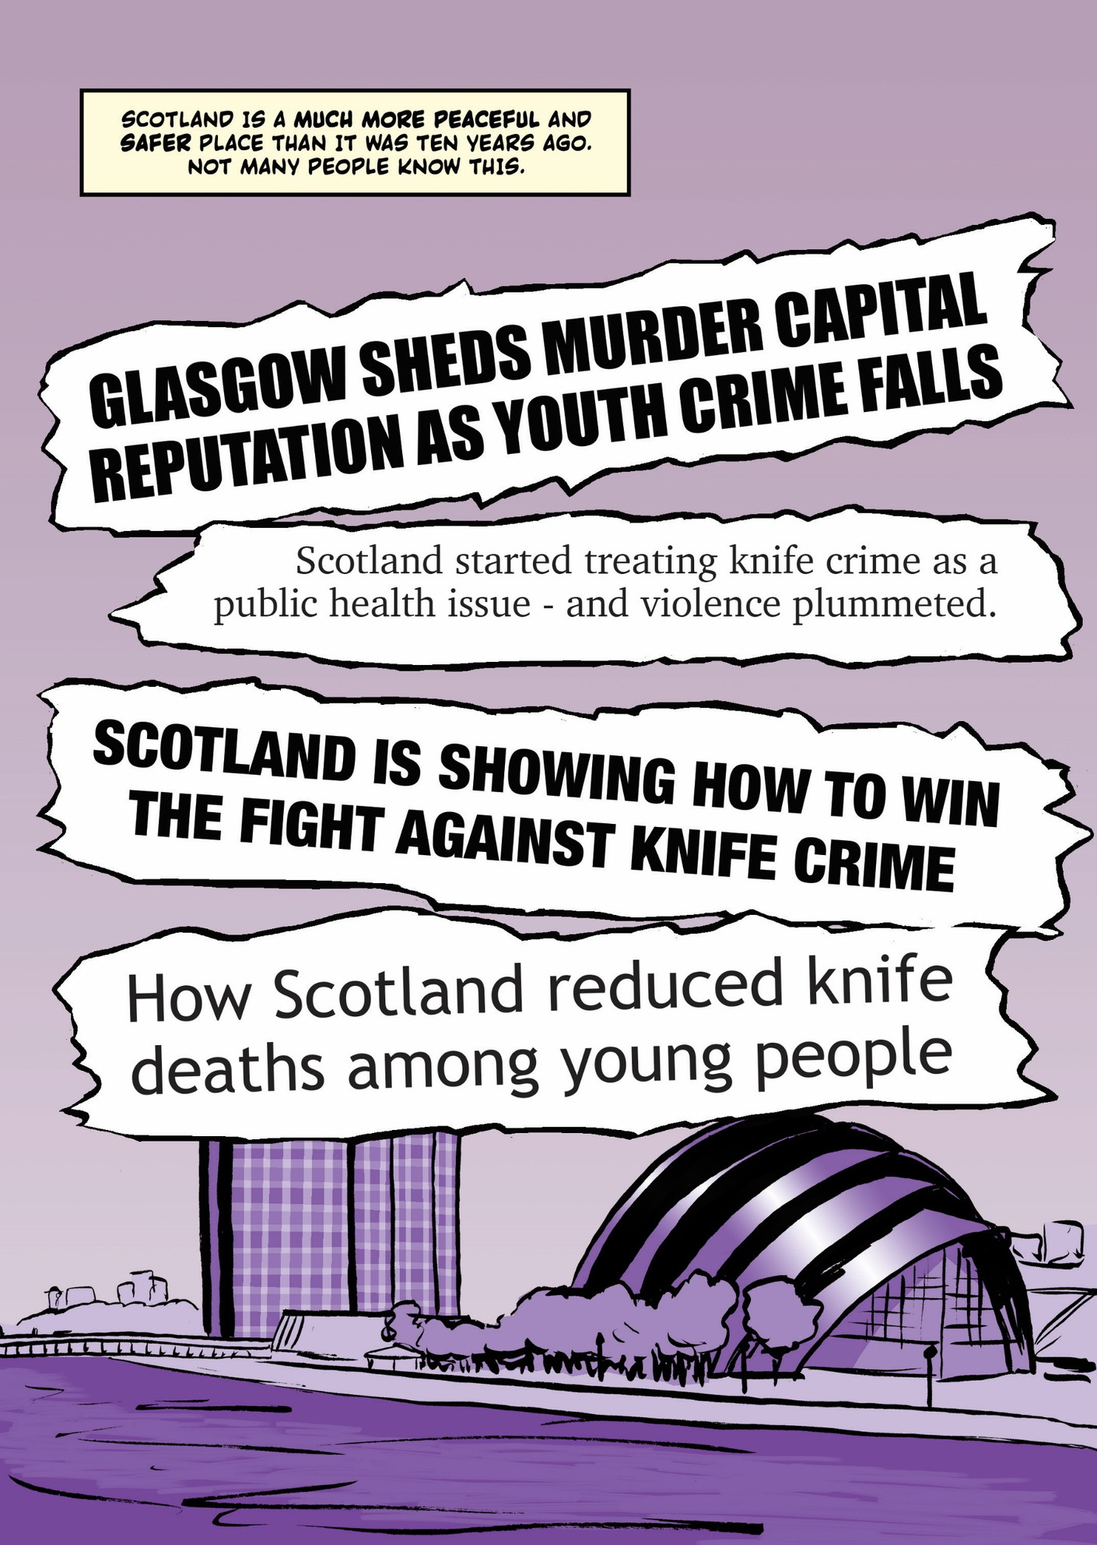
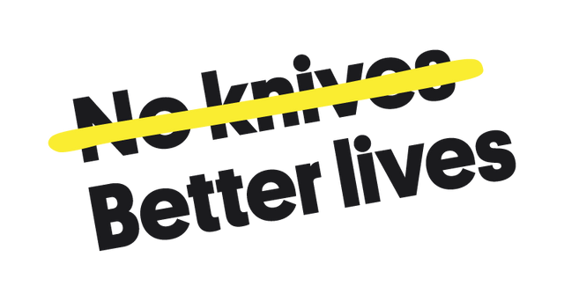

Knife Crime
Mark & Aria

Slide 2



What do you already know?
Stand up
Sit down
True
False
Notes:
1.7.2013
- Play a game of true or false to see what you already know.
‹#›

Slide 3
Stand Up, Sit Down
1. Glasgow is the ‘murder capital of Europe’​.
2. It’s mostly teenagers who get caught carrying knives​.
3. Boys rather than girls are more likely to be the victims of knife crime​.
4. People carry knives for their own protection​.
5. Scaring people is the best way to stop them from carrying knives.
Notes:
– prevention is better than a cure.
-that we owe to our citizens, especially our younger and more vulnerable citizens (UNCRC – it is a human right to live life safe from fear and fear of violence)
- If we stop prevention work, we may experience an upturn in violence.
– we should practice prevention as a matter of course, not after a news headlining violent incident.
– we need to keep trying to end the conditions that drive violence in our society as a matter of principle.
- In 2021-22, 126 crimes of handling an offensive weapon (not used) occurred within a school. This compares to 74 in 2020-21 (a significant increase of 70% though on small numbers). When used where a crime has been committed - in 2021-22, 102 crimes of handling an offensive weapon (used) occurred within a school, compared to 36 in 2020-21. (a significant increase of 183% though on small numbers)

Slide 4
Why is this topic important?
Raising awareness
Myth Busting
Prevention
Empowerment
Starting the conversation
Notes:
– prevention is better than a cure.
-that we owe to our citizens, especially our younger and more vulnerable citizens (UNCRC – it is a human right to live life safe from fear and fear of violence)
- If we stop prevention work, we may experience an upturn in violence.
– we should practice prevention as a matter of course, not after a news headlining violent incident.
– we need to keep trying to end the conditions that drive violence in our society as a matter of principle.
- In 2021-22, 126 crimes of handling an offensive weapon (not used) occurred within a school. This compares to 74 in 2020-21 (a significant increase of 70% though on small numbers). When used where a crime has been committed - in 2021-22, 102 crimes of handling an offensive weapon (used) occurred within a school, compared to 36 in 2020-21. (a significant increase of 183% though on small numbers)

Slide 5
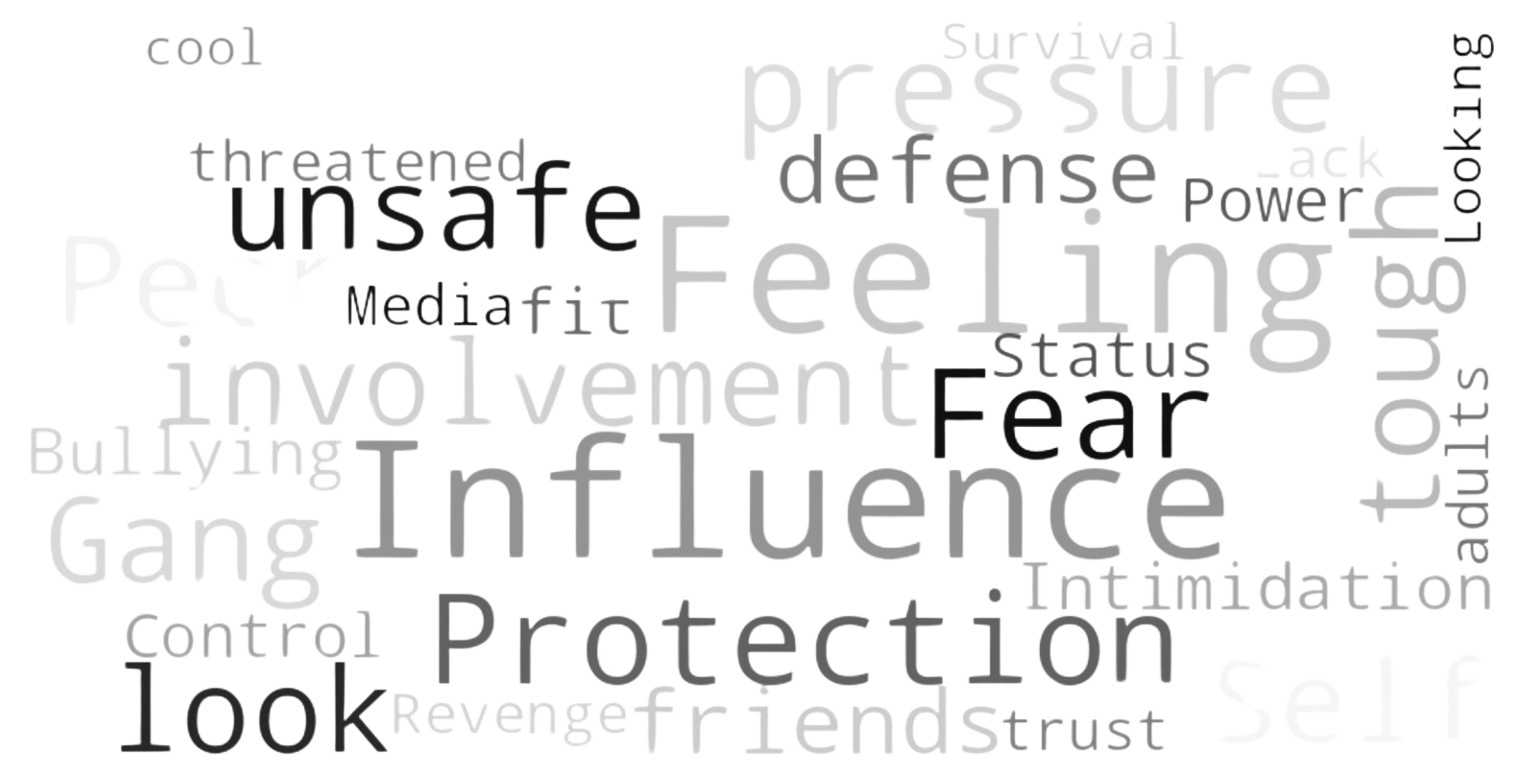
Why do young people carry knives?
Notes:
– prevention is better than a cure.
-that we owe to our citizens, especially our younger and more vulnerable citizens (UNCRC – it is a human right to live life safe from fear and fear of violence)
- If we stop prevention work, we may experience an upturn in violence.
– we should practice prevention as a matter of course, not after a news headlining violent incident.
– we need to keep trying to end the conditions that drive violence in our society as a matter of principle.
- In 2021-22, 126 crimes of handling an offensive weapon (not used) occurred within a school. This compares to 74 in 2020-21 (a significant increase of 70% though on small numbers). When used where a crime has been committed - in 2021-22, 102 crimes of handling an offensive weapon (used) occurred within a school, compared to 36 in 2020-21. (a significant increase of 183% though on small numbers)

Slide 6
Consequences
Legal:
Arrest and criminal record
Serve time
Fines or community service
Travel restrictions
Future job prospects
Notes:
– prevention is better than a cure.
-that we owe to our citizens, especially our younger and more vulnerable citizens (UNCRC – it is a human right to live life safe from fear and fear of violence)
- If we stop prevention work, we may experience an upturn in violence.
– we should practice prevention as a matter of course, not after a news headlining violent incident.
– we need to keep trying to end the conditions that drive violence in our society as a matter of principle.
- In 2021-22, 126 crimes of handling an offensive weapon (not used) occurred within a school. This compares to 74 in 2020-21 (a significant increase of 70% though on small numbers). When used where a crime has been committed - in 2021-22, 102 crimes of handling an offensive weapon (used) occurred within a school, compared to 36 in 2020-21. (a significant increase of 183% though on small numbers)

Slide 7
Consequences
Social:
Impact on education
Loss of trust from friends and family
Stigma and reputation
Increase risk of violence
Fear and isolation
Notes:
– prevention is better than a cure.
-that we owe to our citizens, especially our younger and more vulnerable citizens (UNCRC – it is a human right to live life safe from fear and fear of violence)
- If we stop prevention work, we may experience an upturn in violence.
– we should practice prevention as a matter of course, not after a news headlining violent incident.
– we need to keep trying to end the conditions that drive violence in our society as a matter of principle.
- In 2021-22, 126 crimes of handling an offensive weapon (not used) occurred within a school. This compares to 74 in 2020-21 (a significant increase of 70% though on small numbers). When used where a crime has been committed - in 2021-22, 102 crimes of handling an offensive weapon (used) occurred within a school, compared to 36 in 2020-21. (a significant increase of 183% though on small numbers)

Slide 8
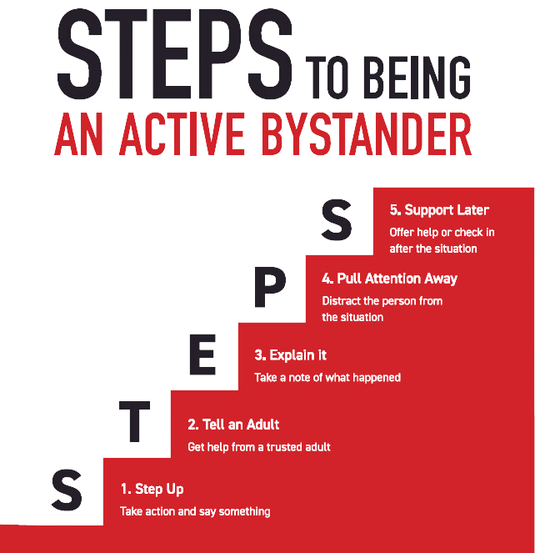
How to help a friend
Notes:
– prevention is better than a cure.
-that we owe to our citizens, especially our younger and more vulnerable citizens (UNCRC – it is a human right to live life safe from fear and fear of violence)
- If we stop prevention work, we may experience an upturn in violence.
– we should practice prevention as a matter of course, not after a news headlining violent incident.
– we need to keep trying to end the conditions that drive violence in our society as a matter of principle.
- In 2021-22, 126 crimes of handling an offensive weapon (not used) occurred within a school. This compares to 74 in 2020-21 (a significant increase of 70% though on small numbers). When used where a crime has been committed - in 2021-22, 102 crimes of handling an offensive weapon (used) occurred within a school, compared to 36 in 2020-21. (a significant increase of 183% though on small numbers)

Slide 9




Support
Notes:
– prevention is better than a cure.
-that we owe to our citizens, especially our younger and more vulnerable citizens (UNCRC – it is a human right to live life safe from fear and fear of violence)
- If we stop prevention work, we may experience an upturn in violence.
– we should practice prevention as a matter of course, not after a news headlining violent incident.
– we need to keep trying to end the conditions that drive violence in our society as a matter of principle.
- In 2021-22, 126 crimes of handling an offensive weapon (not used) occurred within a school. This compares to 74 in 2020-21 (a significant increase of 70% though on small numbers). When used where a crime has been committed - in 2021-22, 102 crimes of handling an offensive weapon (used) occurred within a school, compared to 36 in 2020-21. (a significant increase of 183% though on small numbers)

Slide 10


Any questions?
Notes:
- started in November 22
- two separate groups meeting every other week
- why did you want to get involved?

