Slide 1
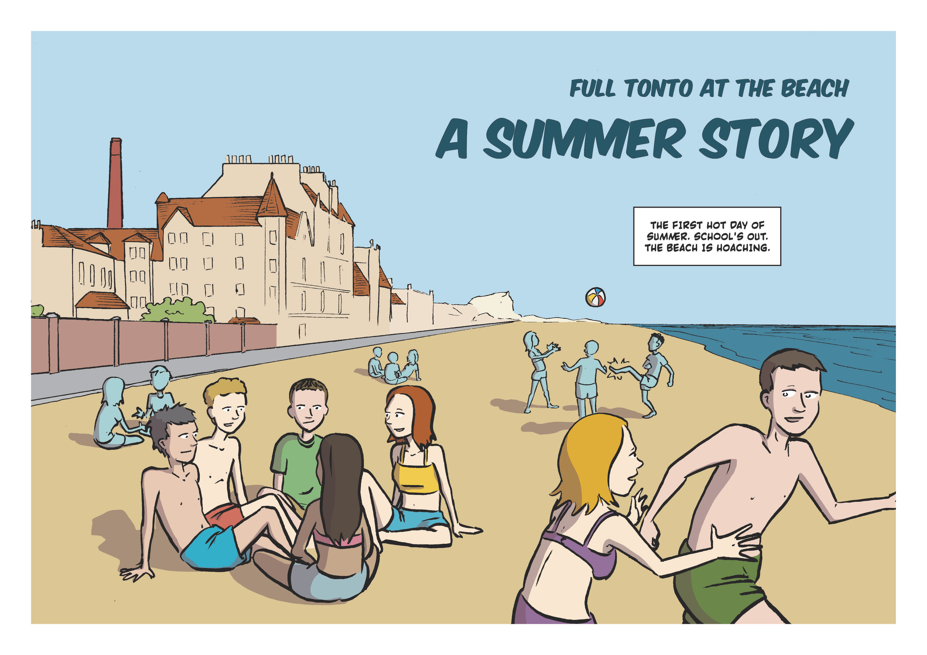
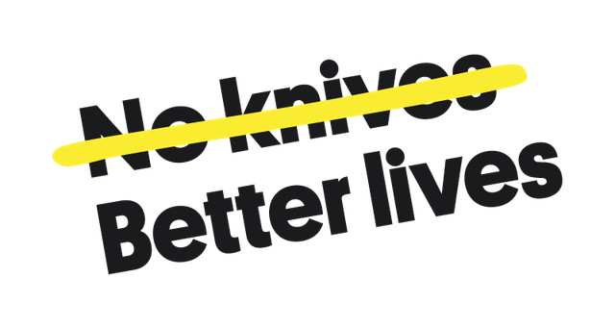
A Summer Story
How would you react and how can you help your friends and others?

Slide 2
Read ‘A Summer Story’
Think about:
  What do you think is happening?
  Where might this happen in your community?
  Could anything have been done to stop the situtation?

Slide 3


Slide 4
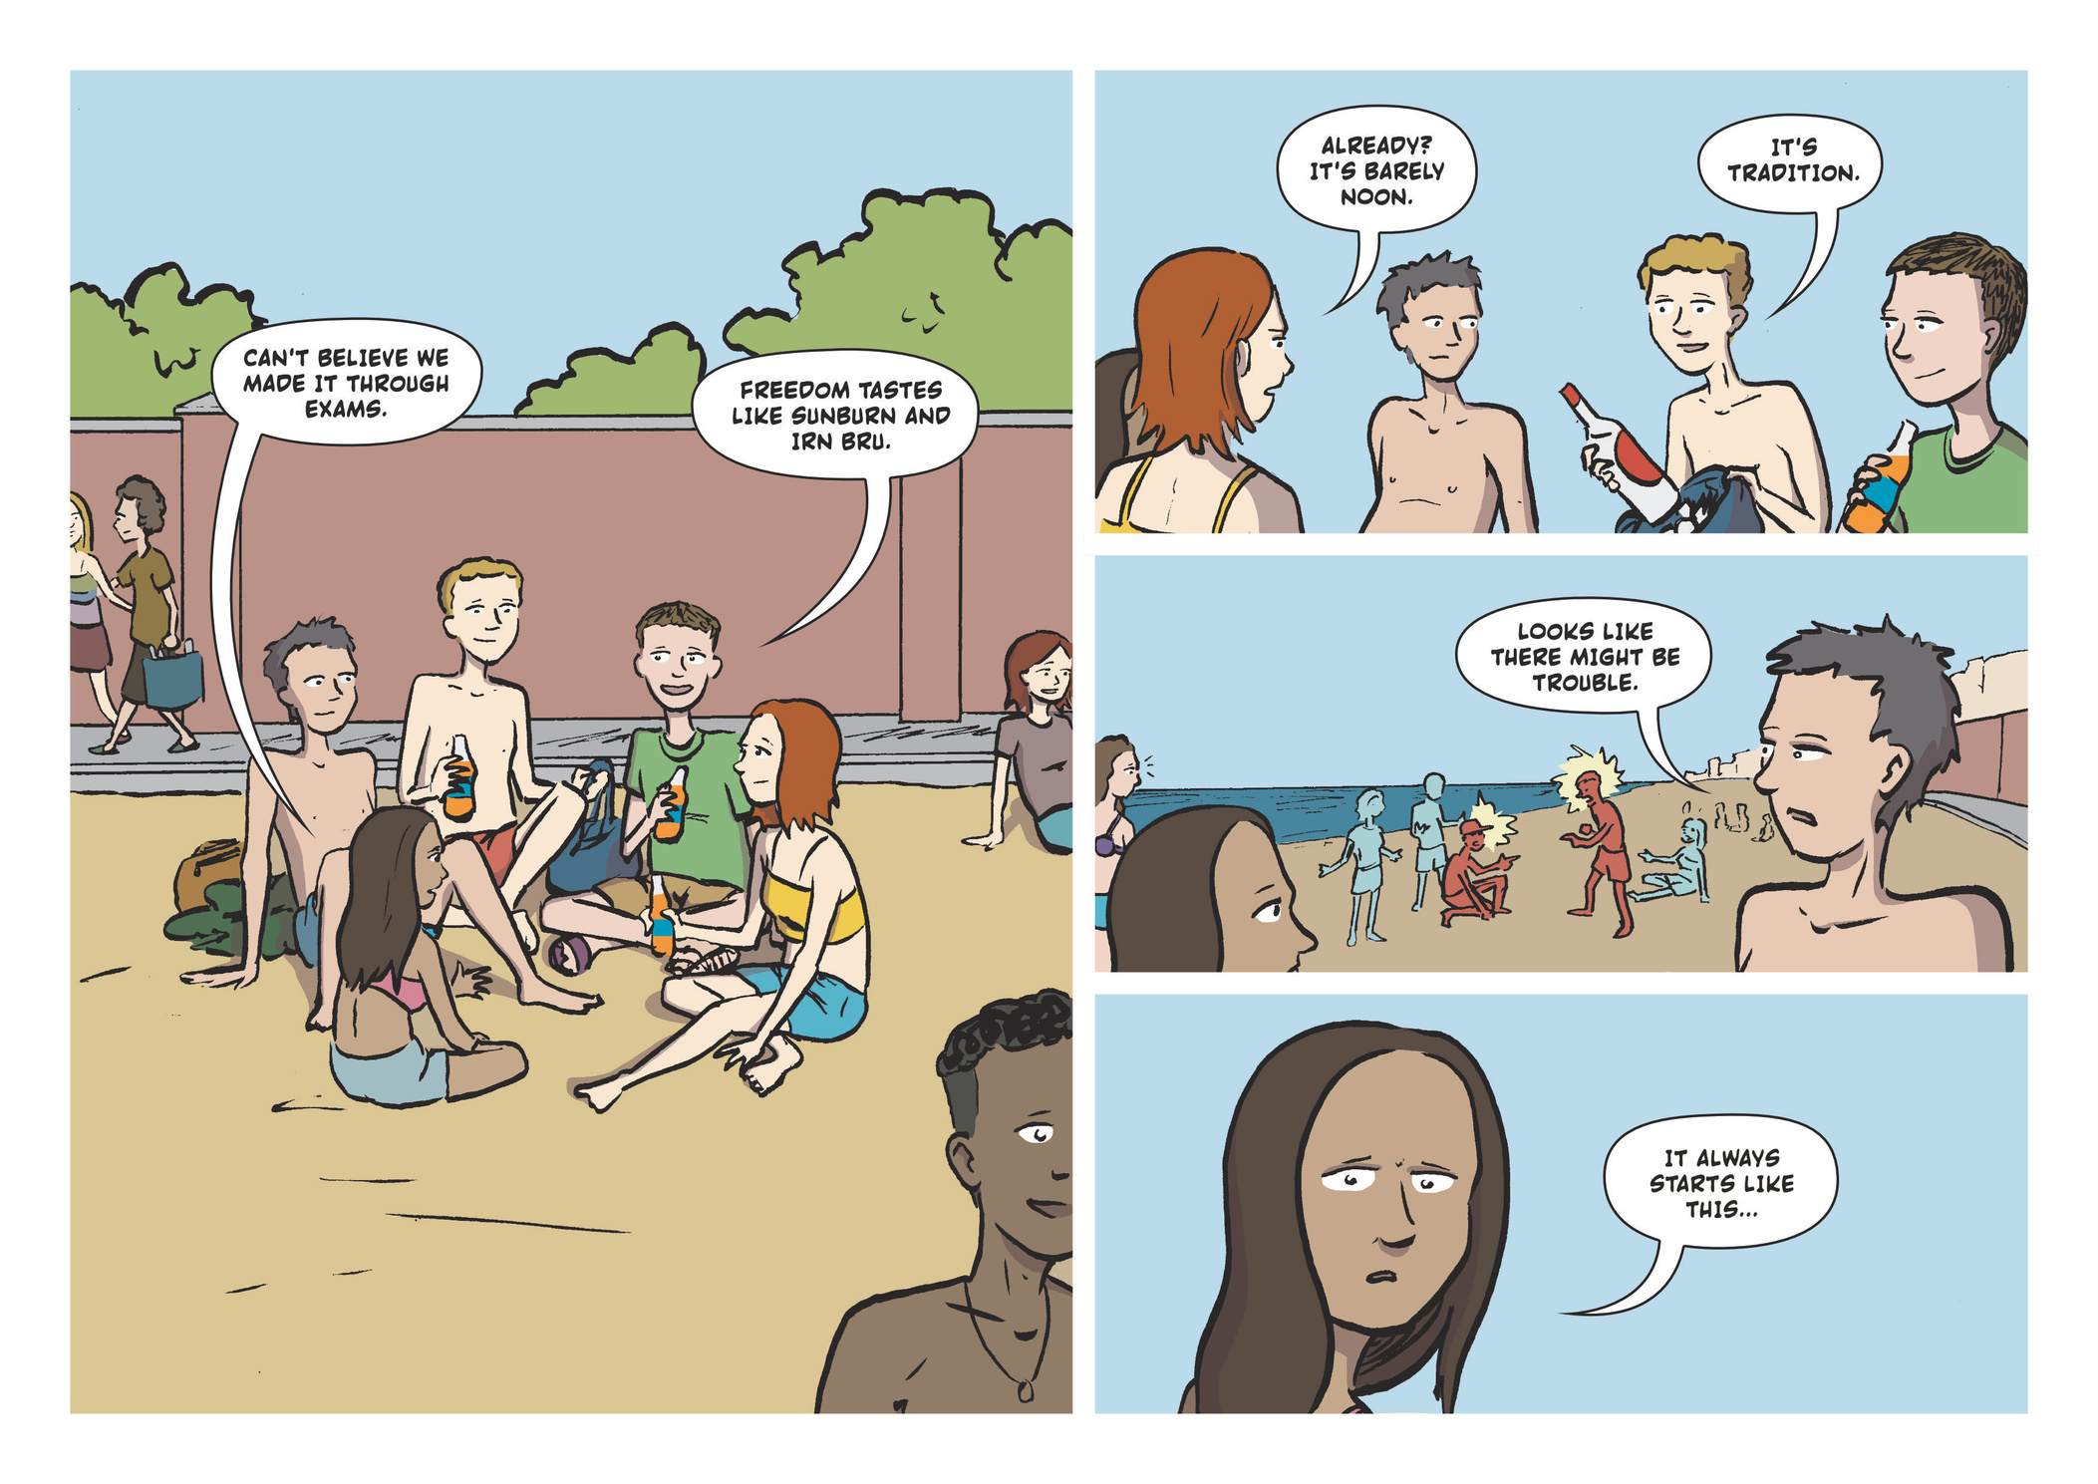

Slide 5
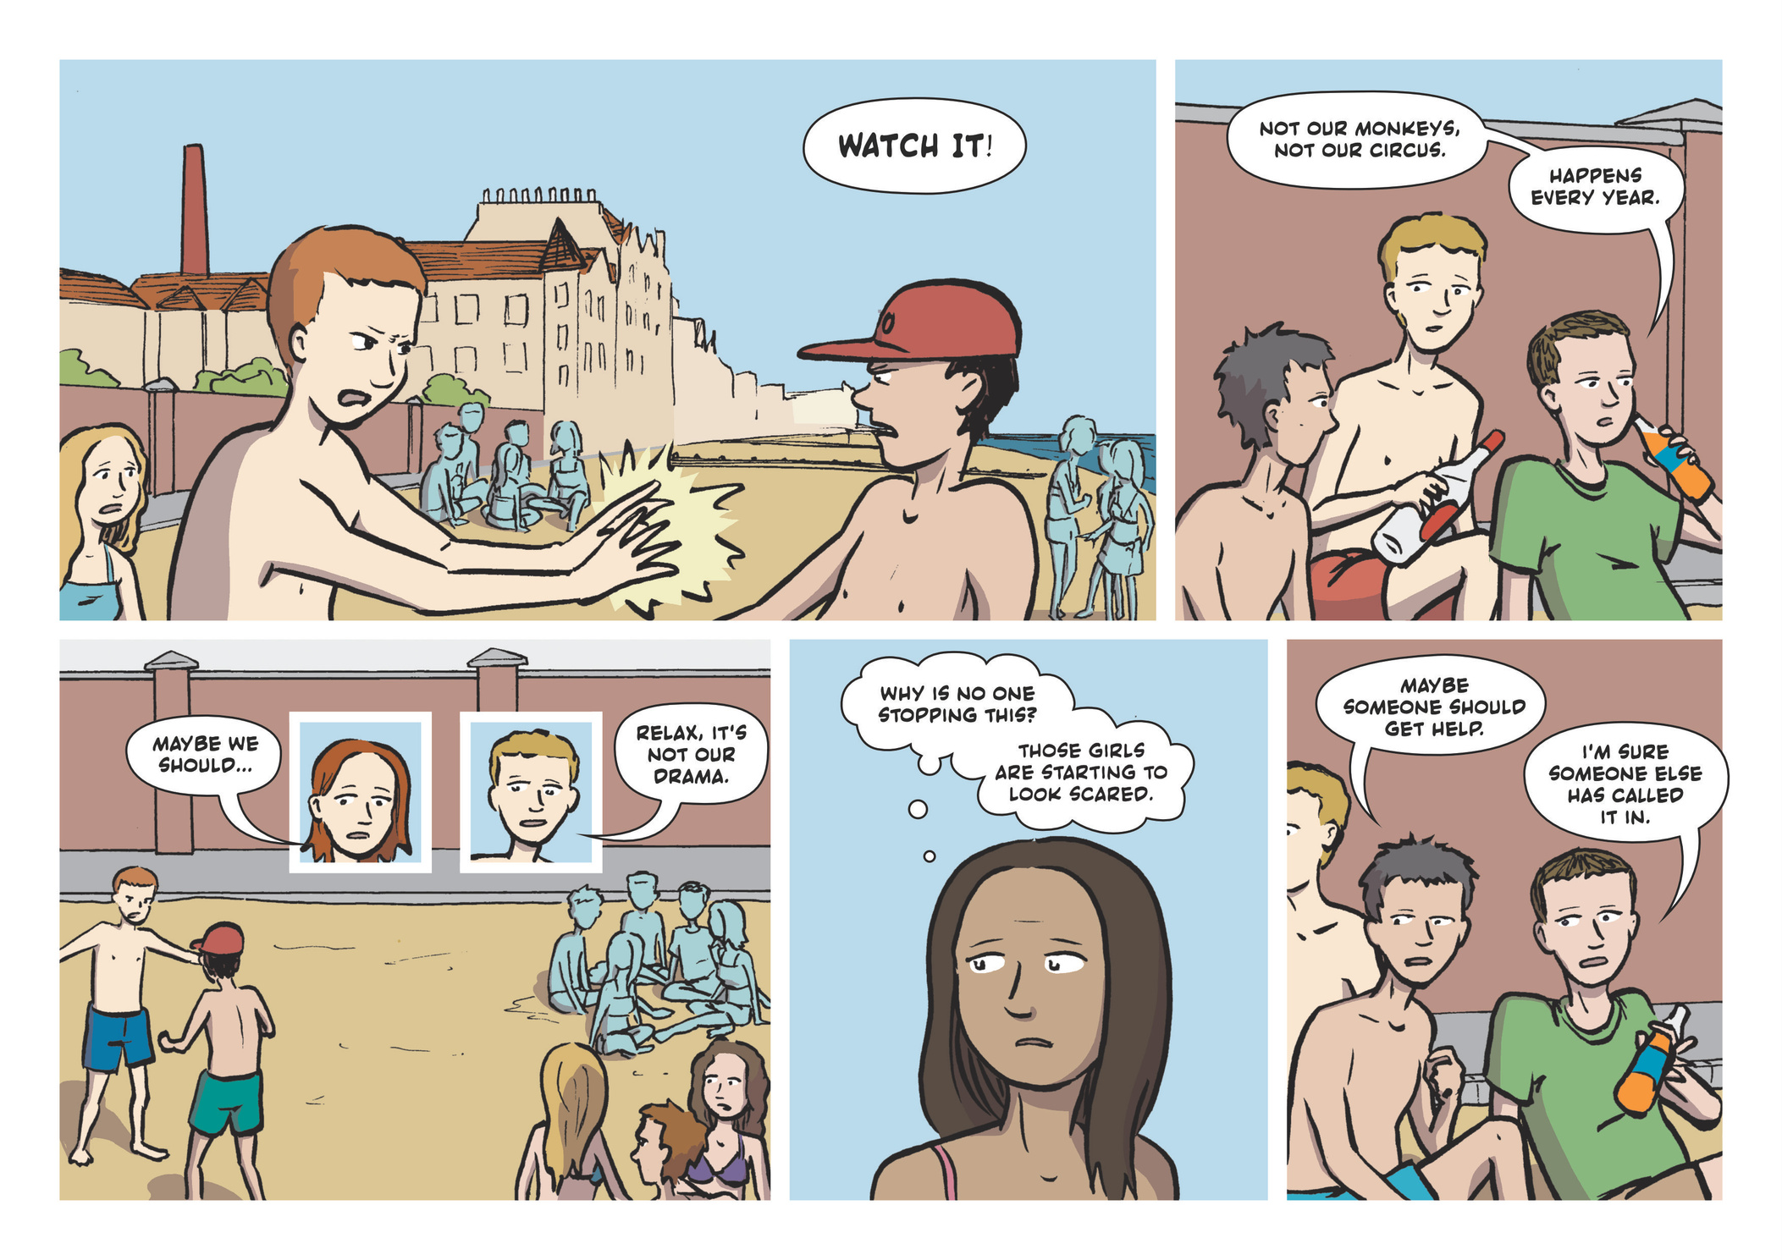

Slide 6
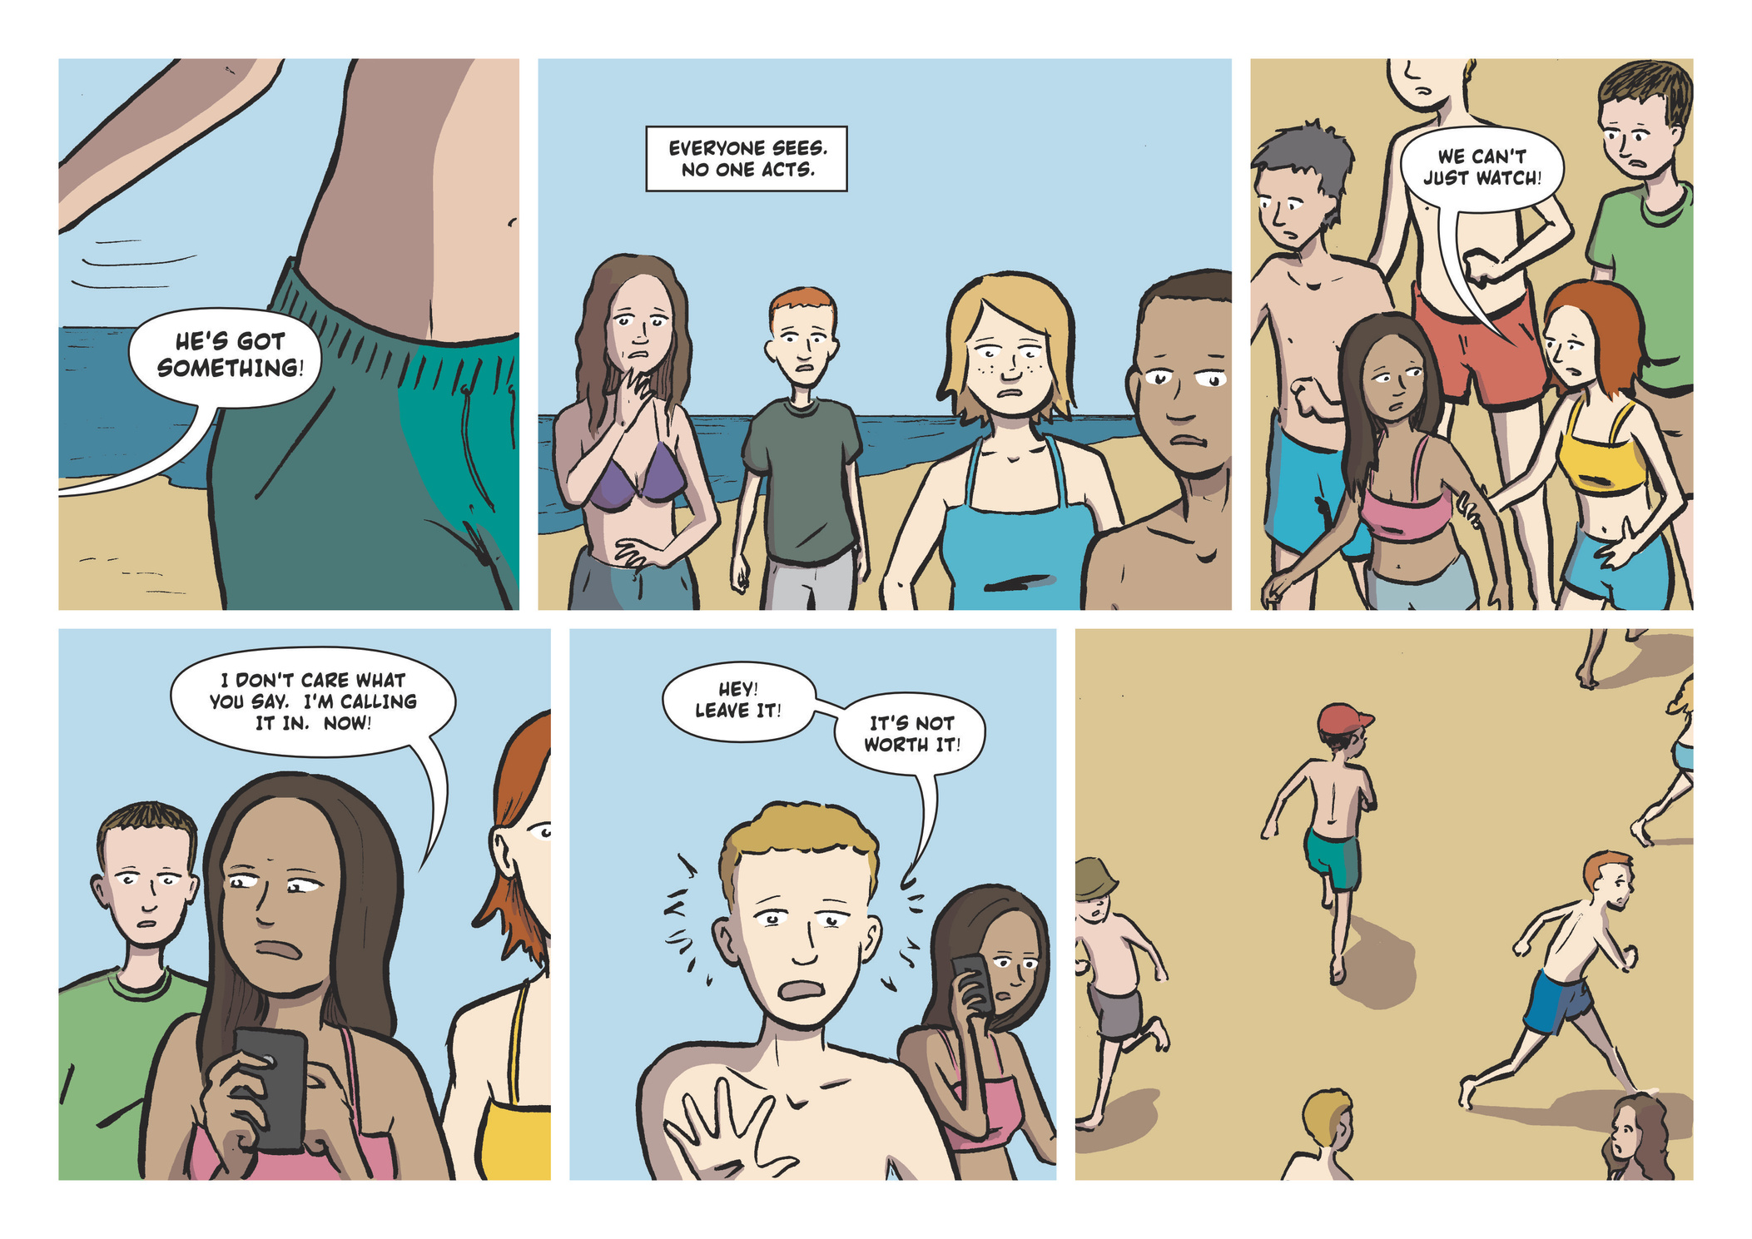

Slide 7
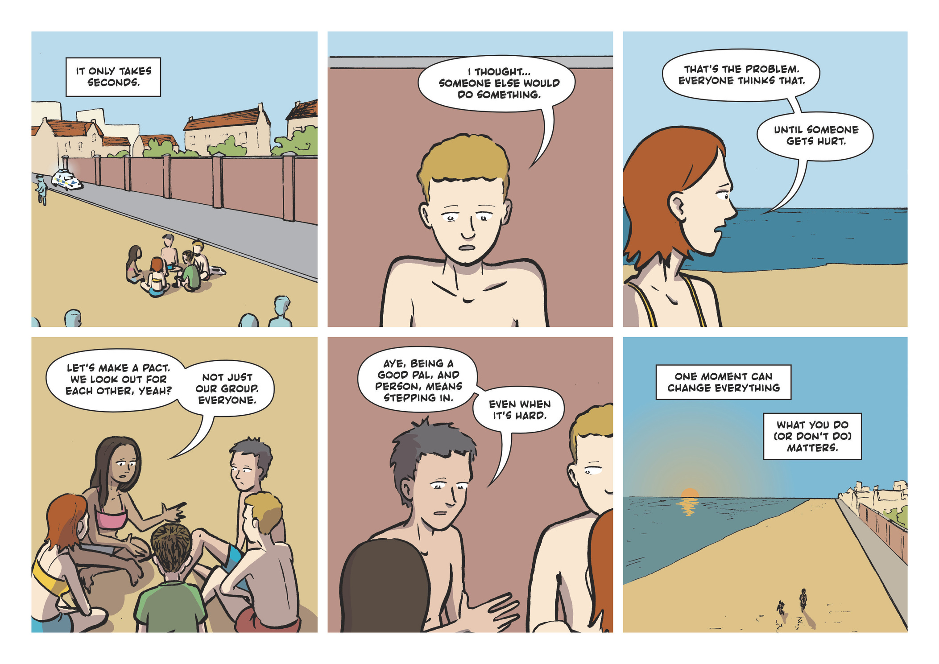

Slide 8
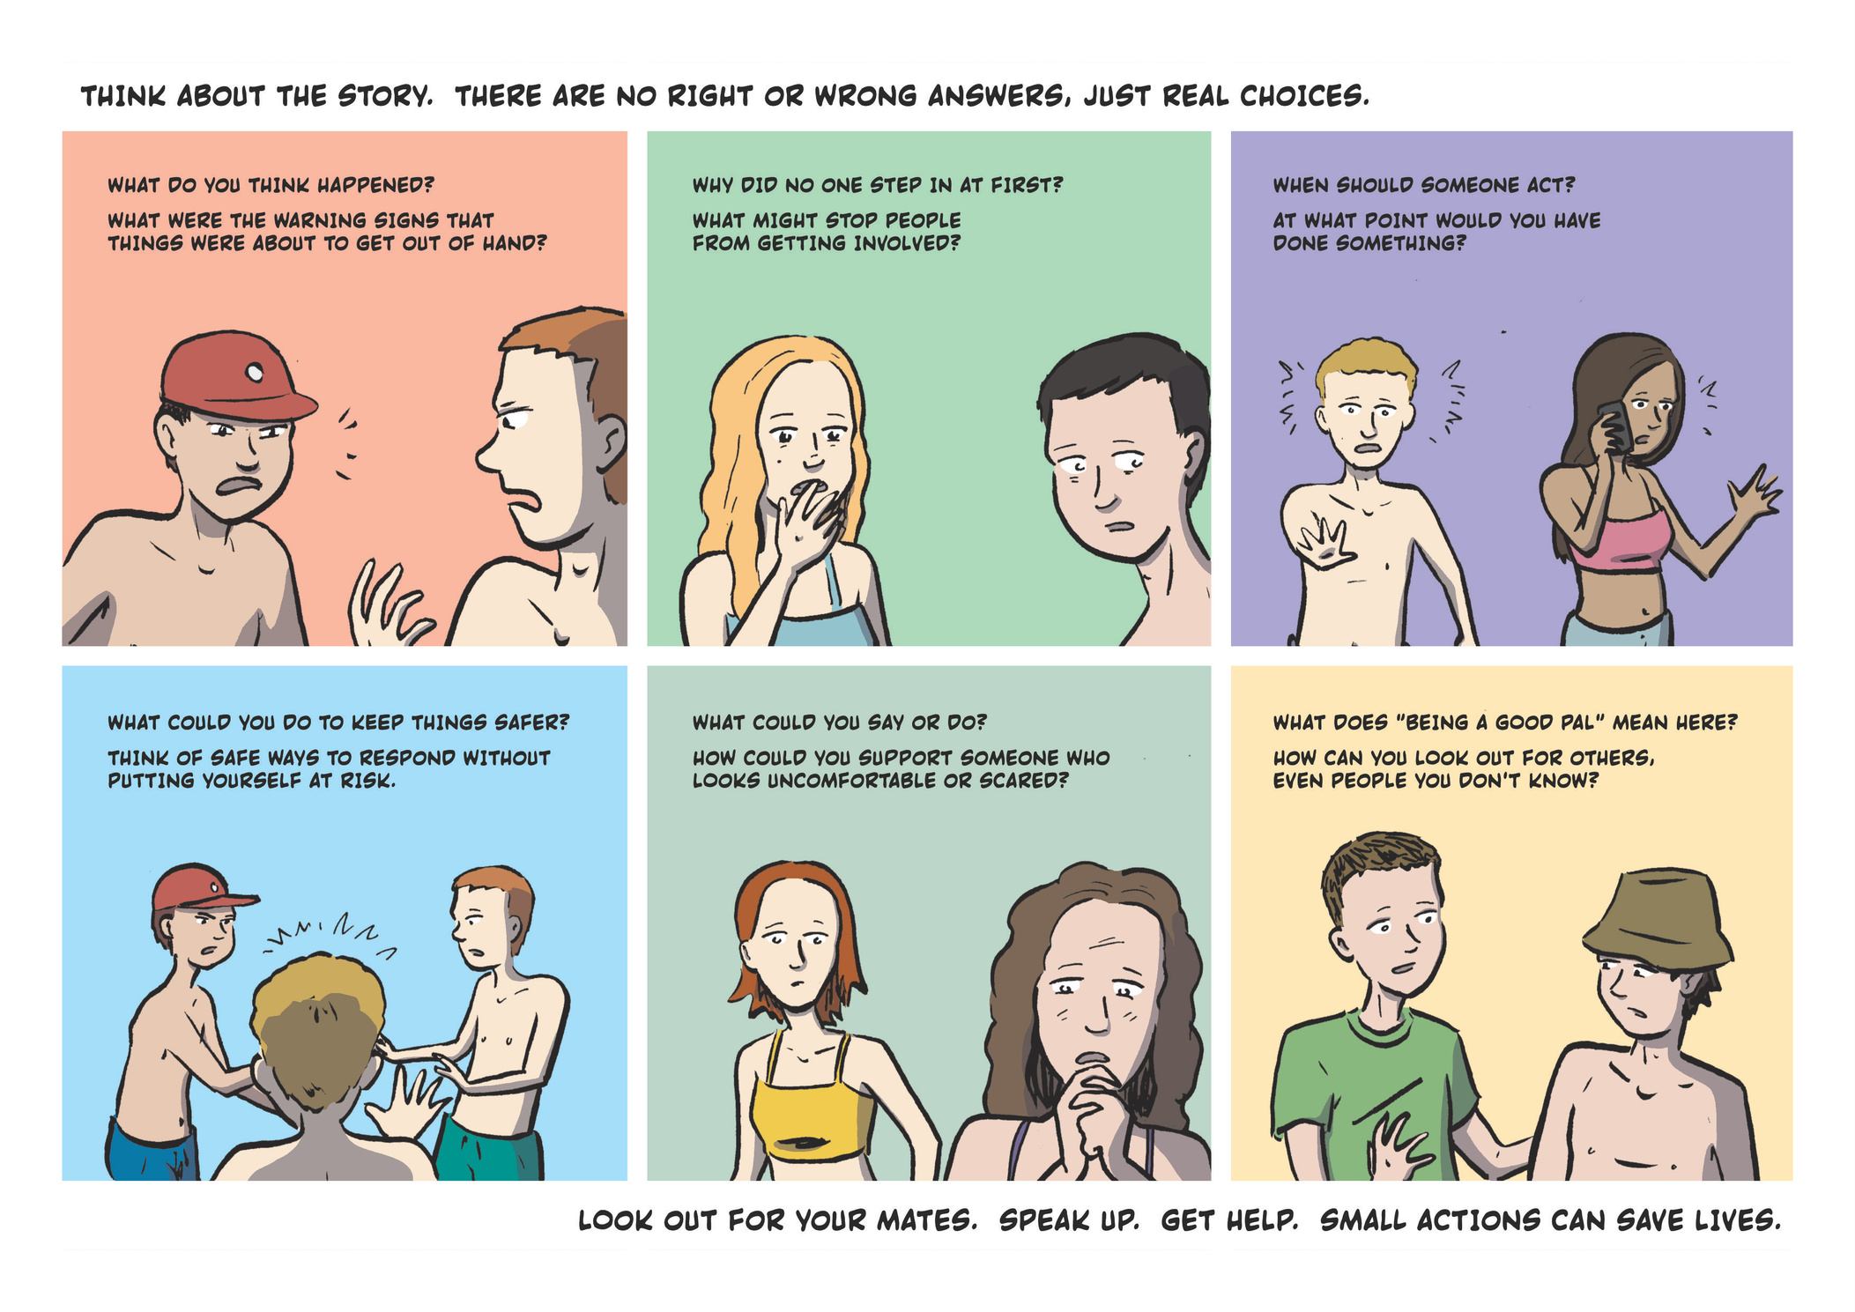
Split into six groups ready for a discussion - make some notes ready to feedback to the whole class
Sp

Slide 9
Group 1 : See the signs
What do you think happened?
What were the warning signs that things were about to get out of hand?
Discuss
Have you experienced anything similar?

Slide 10
Group 2: Stepping up
Why did no one step in at first?
What might stop people from getting involved?
Discuss
Have you ever had to step up to help? How did you feel?
Are there things that stop you from stepping up? What can you do to overcome them?

Slide 11
Group 3: When to act
When should someone act?
At what point would you have done something?
Discuss
Have you ever regretted not doing something, or maybe you stepped in too early?
What’s the best time to step up?

Slide 12
Group 4: Keeping safer
What could you do to keep things safer
Think of safe ways to respond without putting yourself at risk.
Discuss
When you do stuff with your mates, do you think about staying safe?
How could you take action but still keep safe yourself?

Slide 13
Group 5: Reassurance
What could you say or do?
How could you support someone who looks uncomforatble or scared
Discuss
Have you had to reassure someone who was worried before? How did that feel?
Can you think of ways to reassure someone in a moment like this?

Slide 14
Group 6: Being a pal
What does ‘being a good pal’ mean here?
How can you look out for others, even people you dont know?
Discuss
What ways do good friends help each other, even when it’s difficult or the other person doesnt seem to want the help?
How do you balance being friends to your close mates with all the other people in a situation?

Slide 15
What did you come up with?
Class discussions:
  Do you think you’ve been (or might be) in some similar situations?
  Where could you get help?
  What could you do to help?- but staying safe

Slide 16
What next
  Did you get some good ideas to deal with it?
  Why not create your own comic, a poster, or social media post and share in the school?
  Look out for each other this summer
  Dont forget to feed back to the NKBL team too!

Slide 17
No Knives Better Lives
  Find more information online at our website noknivesbetterlives.com
  Follow us on socials
  Do some more activities about violence prevention in your school or organise a campaign (get in touch and tell us about it!)

Slide 18
Thank You
NKBL@youthlink.scot

